Slide 1
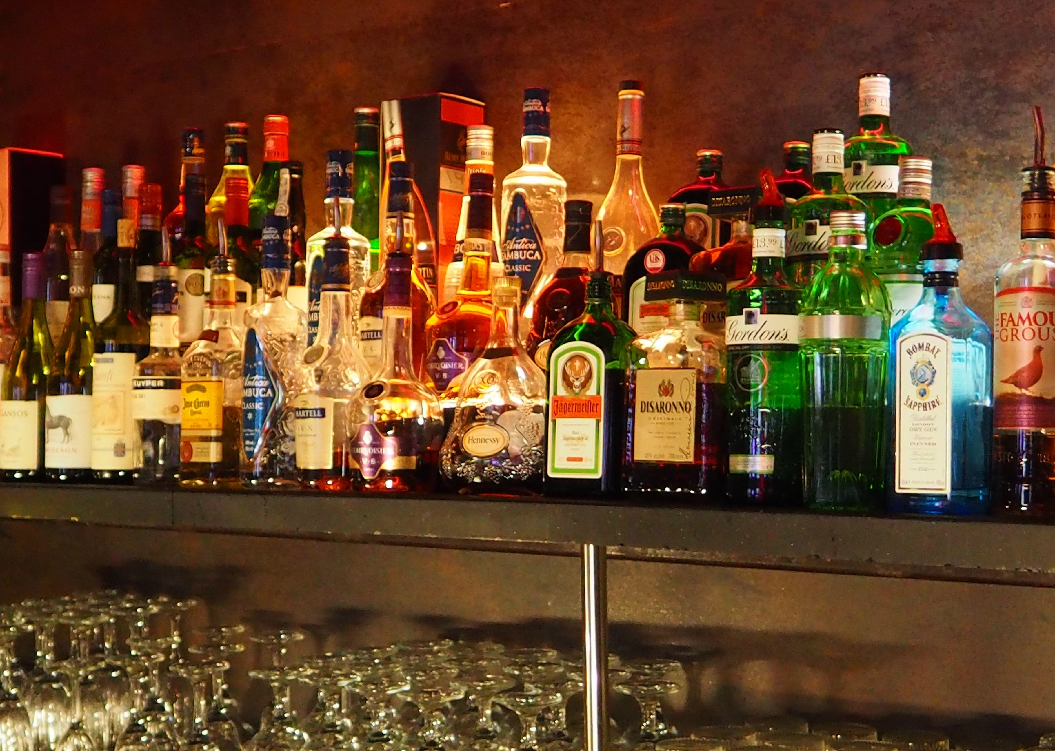
Iowan Alcohol Sales
Mario Monterrosa
John Montes
Danny Olivas

Slide 2

Data Source: Kaggle
https://www.kaggle.com/residentmario/iowa-liquor-sales#Iowa_Liquor_Sales.csv
Dataset size: 3.48GB

Slide 3
Abstract
We analyzed alcohol sales data collected by the State of Iowa. Iowans of all counties love their liquor. Due to laws in the state, alcohol vendors must log all the sales. The log must include the name of the bottle, bottle volume, how many bottles were sold, total sales amount, total volume of sale, and the alcohol category. We used this dataset to find that you are more likely to find vodka in the typical Iowan home, Iowans spend the most money on Jack Daniels Tennessee Whiskey, and the brand that makes the most money is not the same as the brand that sells the most alcohol by volume. Iowans in Polk County always have their flasks filled and ready to go.

Slide 4
Objectives
Load sample set onto HDFS Directory
Create database and tables in Hive
Run queries to find the following:
Top 10 Selling Bottles
Best-Selling Liquor
County with the Most Amount of Alcohol Sold
Top Sales in Dollars vs Top Sales in Volume (Correlation)

Slide 5
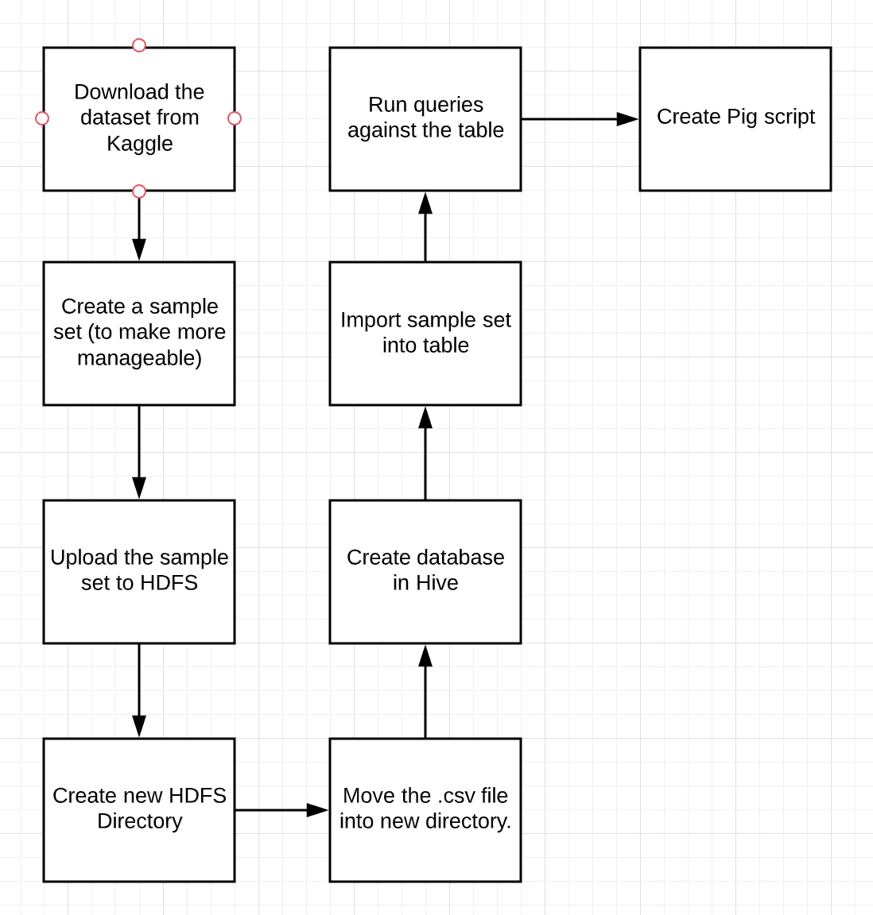
Flow Chart
Our processes

Slide 6
Experimental Specifications:
EMR cluster with 3 nodes: m3.xlarge
Release label: emr-5.27.0
Hadoop distribution: Amazon 2.8.5
Applications: Hive 2.3.5, Pig 0.17.0, Hue 4.4.0, Ganglia 3.7.2, Tez 0.9.2, Sqoop 1.4.7, HCatalog 2.3.5

Slide 7

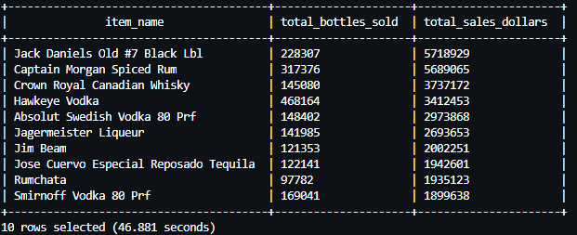
Top 10 Selling Bottles
SELECT item_name, SUM(bottles_sold) AS total_bottles_sold, SUM(sale_dollar) AS total_sales_dollars
FROM iowa_liquor
GROUP BY item_name
ORDER BY total_sales_dollars DESC LIMIT 10;

Slide 8
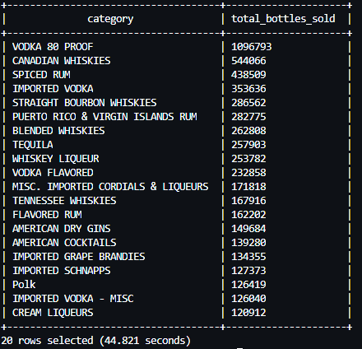
Best-Selling Alcohol Type
SELECT category, SUM(bottles_sold) AS total_bottles_sold FROM alcohol
GROUP BY category Order BY total_bottles_sold DESC LIMIT 20;

Slide 9

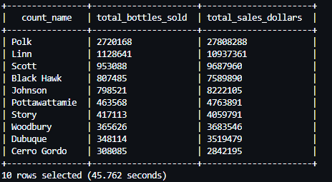
County With Most Alcohol Sales in Iowa
SELECT count_name, SUM(bottles_sold) AS total_bottles_sold, SUM(sale_dollar) AS total_sales_dollars
FROM iowa_liquor GROUP BY count_name
ORDER BY total_bottles_sold DESC LIMIT 10;

Slide 10
Volume Sales vs Dollar Sales
Total Dollar Sales Query
Total Volume Sales Query
SELECT category, SUM(sale_dollar) AS total_dollar_sales
FROM alcohol
GROUP BY category
ORDER BY total_dollar_sales DESC LIMIT 15;
SELECT category, SUM(sale_volume_liter) AS total_volume_sales
FROM alcohol
GROUP BY category
ORDER BY total_volume_sales DESC LIMIT 15;

Slide 11
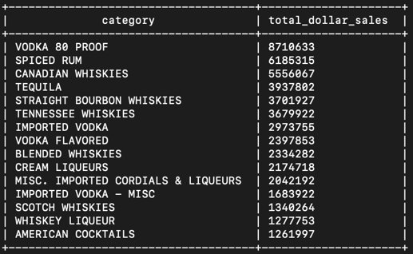
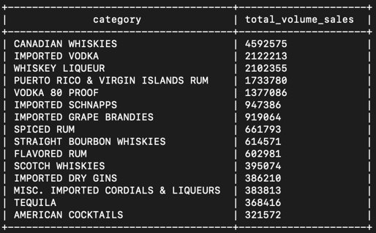
Volume Sales vs Dollar Sales
Total Sales in Dollars
Total Sales per Volume

Slide 12
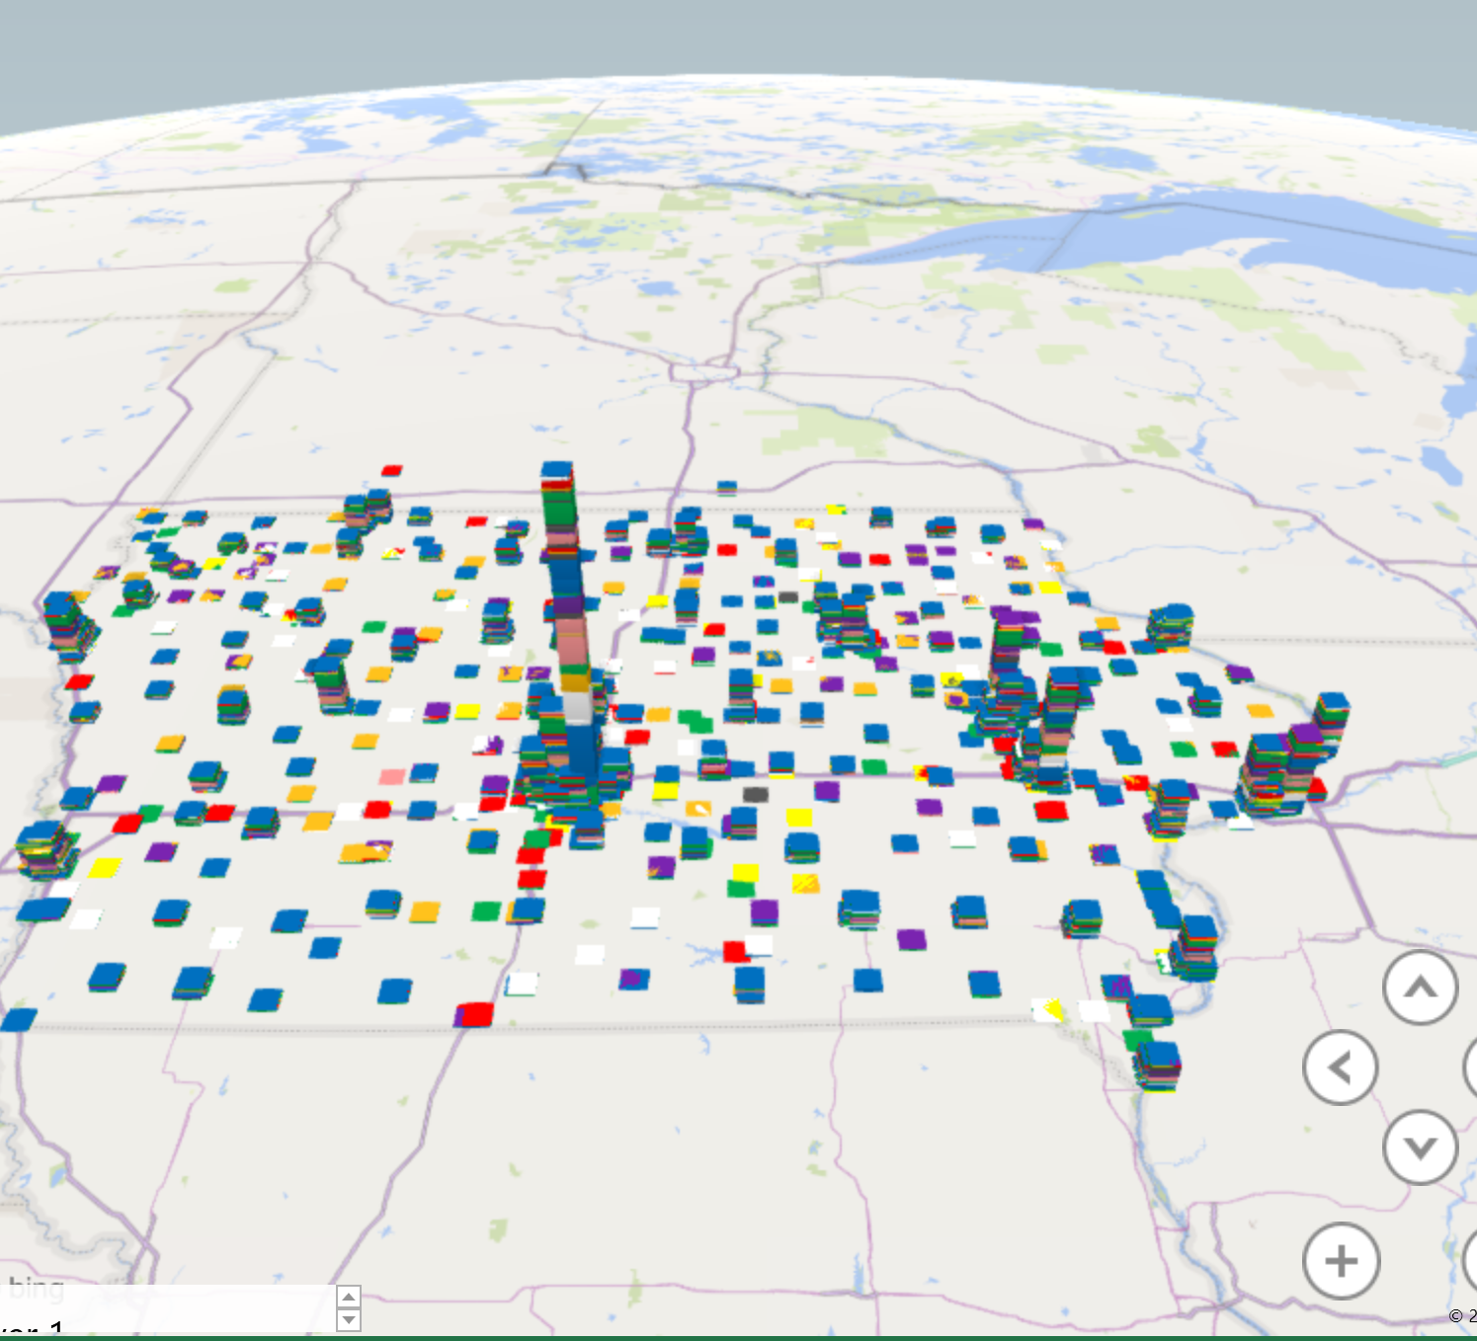
Excel Map (Using Liquor Store Location)
Height: Sales (In Dollars)
Green: Whiskys
Blue: Vodkas
White: Tequila
Red: Gins
Pink: Rums
Purple: Amarettos
Yellow: Brandies
Gray: Flavored Liqueur

Slide 13
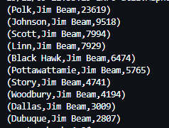
Pig Script/Analysis
Goal: Find the top 10 counties in Iowa that buy the most "Jim Beam" bottles

Slide 14

The End

